Slide 1
BILC
Current Practices & Opportunities
May 2016
Colonel Keith Logeman Assistant Commandant

Slide 2
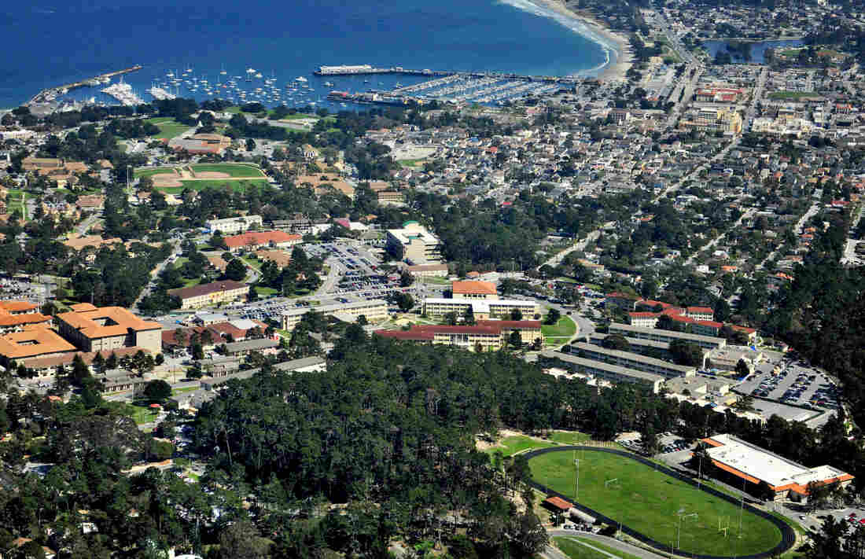
DLIFLC

Slide 3
Overview
Current practices
DLIFLC Testing
Challenges & Opportunities

Slide 4
Mission, Vision, and Values
We hold ourselves and others
accountable for the following values:
Commitment - We are committed to our students, employees, stakeholders, life-long learning, and institutional excellence.
Adaptability – We promote flexibility and drive innovative change as individuals and as an institution.
Integrity - We expect personal and professional integrity.
Respect – We honor our cultural and social diversity by treating others with dignity and respect.
Mission
Values
Our mission is to provide culturally based foreign language education, training, evaluation and sustainment to enhance the security of the nation.
Vision
Our vision is to deliver the world's best culturally based foreign language education and training – at the point of need.
Notes:
With the emphasis across the Department of Defense of Cultural Awareness, we recently added the term ‘culturally based’ to the Mission and Vision statement to acknowledge that culture is important to the language learning process and an integral part of our language programs.
We proudly consider ourselves the best language teaching facility in the world, based on the number of languages we teach, the number of students we graduate, the proficiency at which they leave here, and the speed at which they reach that proficiency level.

Slide 5
Linguistic Readiness
Notes:
(VIDEO file: 20150622_PPS1.wmv)
Theme: DLIFLC effectively and efficiently produces high quality language capability for the Department of Defense through rigorous academic and military training.
Message: Transformation at DLIFLC is in part intended to centralize DoD language training to remove redundancy and exploit expertise and efficiencies.
Video description: The Defense Language Institute Foreign Language Center, the Department of Defense’s premier language training provider, is the largest, most efficient and effective, foreign language educational institution in the nation. An organization founded in the shadow of World War II, today the Institute continues to adapt to meet the requirements for our nation’s security.
The Institute currently teaches twenty-three languages at the Presidio of Monterey, while another sixty-five languages are offered through its branch in Washington D.C. At any given time there are approximately 4,000 students attending the Institute from the Department of Defense, other U.S. government agencies as well as a small number of military students from allied nations. To ensure the best possible training for future language professionals, students are taught by highly educated instructors, 95% of whom are native speakers of the languages they teach.

Slide 6
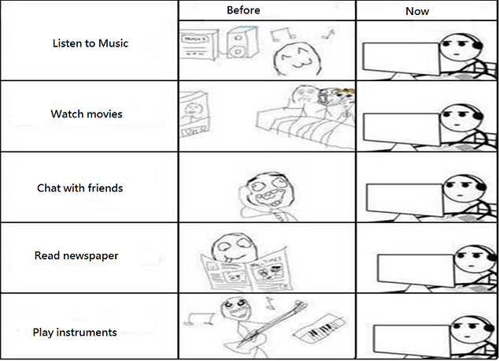
Before vs. Now

Slide 7
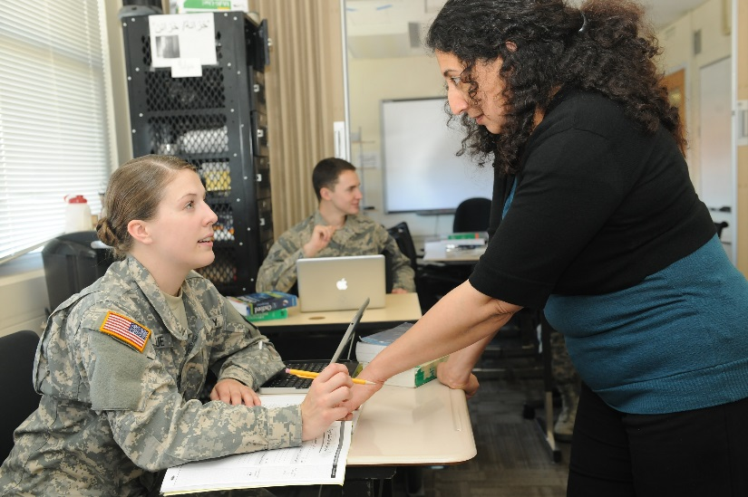
Undergraduate Student Profile (ILR 2/2/1+)
~ 3,500 multi-service
66% - under age 25
99% - high school graduates
17% - college graduates
6% - officers
71% male population
29% female population
87% - students will support intelligence agencies
Schedule: 5 days/week, 6+ hrs
per day, 2-3 hrs homework
38%
12,300 AA degrees awarded
since 2002
Notes:
Updated as of Aug. 20, 2015

Slide 8
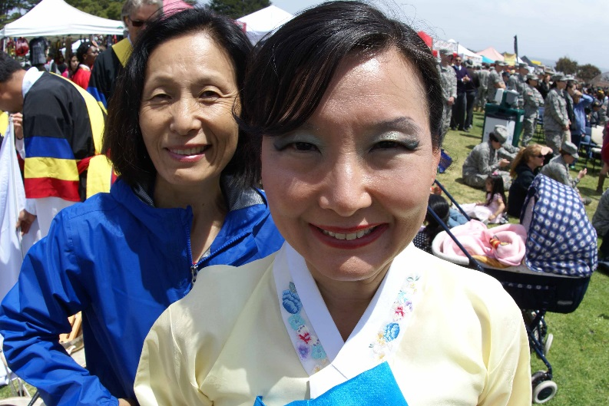
Faculty Profile
Title 10 Department of the Army civilian faculty
95% native speakers: 16% Ph.D., 56% M.A., 25% B.A
DLI-Washington: Contract faculty
provide flexibility and surge capacity
In-house faculty training programs
Professional development
opportunities through local and
regional higher educational
institutions
Title 10 DA civilian faculty – Faculty Personnel System allows for flexibility
with the surge and dips in language training requirements
Notes:
As of Aug. 20, 2015
THEME: DLIFLC is a highly adaptive and responsive organization, responding to the needs of the Services and other DoD agencies.
30 % of the Title 10 faculty are tenured.
1,400 teachers approx. are not tenured and do not have secure jobs.
current starting salary is $57K
Title 10 DA allows for a certain degree of flexibility with the surge and dips in language training requirements. Instructors are no longer forced to leave the classroom to be mangers if they are promoted. They can continue to do the job they love and receive merit pay points. The system also allows instructors to move from the classroom to other departments that deal with curriculum development, faculty training, testing, or a Language Training Detachment.
Regardless of faculty degrees, DLIFLC has specific teaching methodology and each instructor must be trained via Instructor Certification Course (ICC) 160 hours to learn the DLI-way, from curriculum, teaching methodology and use of technology, to how to relate to students in a military environment.
Faculty receive training throughout their career at DLI, mandatory and voluntary training – from techniques on teaching grammar to how to create interesting and attractive curriculum for the technology savvy student.
DLIFLC provides 100 % TUITION ASSISTANCE currently – to instructors who wish to pursue higher education degrees in the area of foreign language acquisition. The Institute approves tuition assistance on a course-by-course basis – and has established close working relationships with local universities (and beyond) where programs have been tailored to the needs of our instructors, to include language science and technology.

Slide 9
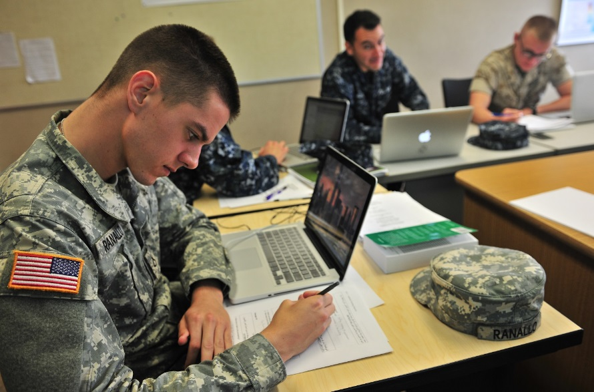
DLIFLC Languages
Category I
Spanish
French
Category II
Indonesian
Category III
Persian Farsi
Russian
Urdu
Hebrew
Tagalog
Category IV
Modern Standard Arabic
Arabic - Egyptian
Arabic – Sudanese
Arabic - Levantine
Arabic - Iraqi
Chinese Mandarin
Korean
Japanese
Pashto
94% of Students taking CAT III & IV Languages
Course Lengths
CAT I – 26 Weeks
CAT II – 35 Weeks
CAT III – 48 Weeks
CAT IV – 64 Weeks
Notes:
* Spanish has been extended by 10 weeks beginning FY16. French will be extended in FY17.
Began teaching Egyptian Arabic end of July 2014. Sudanese first course started in Aug. 2015, earlier than expected.
In 2014 we closed: Italian and Thai department. Tagalog (Philippines) next to go. Dari ended July 2015.
In Jan 2016, announced the closure of: Portuguese, German, Serbian/Croatian, Hindi, and Turkish.

Slide 10
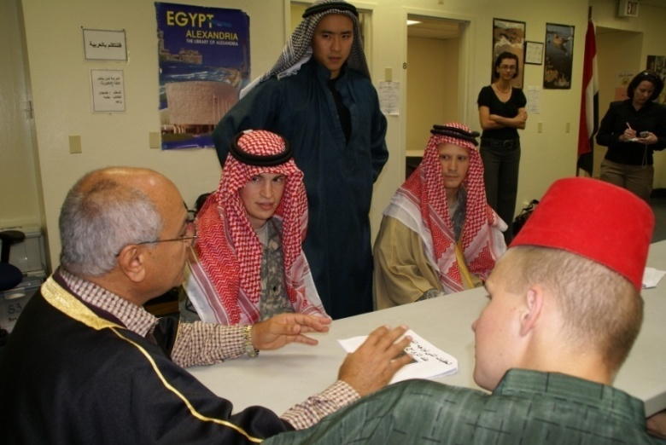
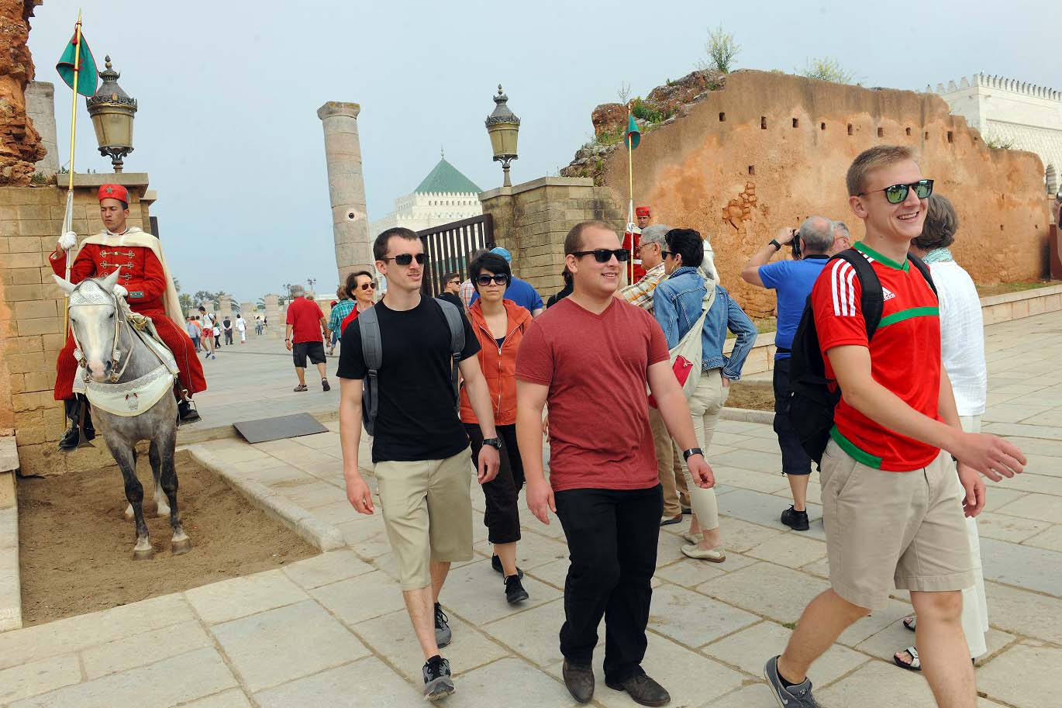
Immersion Programs
Local Immersions
OCONUS
Initiated August 2005
20+ countries/regions
more than 3,000 + participants
70%+ for Arabic, Chinese, Korean
2006 - dedicated Immersion facility at Ord Military Community
Immersions conducted twice per language program
Students who participate in immersions gain significantly higher levels of proficiency with far less attrition
Notes:
08/21/2015 Currently about 15% of our students go on OCONUS immersion, with a plan to send about 50% by 2021. Nearly all students participate in FTX immersions. See list of languages for FTX below.
OCONUS Immersions:
30-35 instructional hours/week
1-2 hours daily HW
One-on-one tutoring
Guest-speaker lectures
Weekend cultural excursions
Program Length:
4-6 weeks for Basic Course students
2-4 weeks for Intermediate/Advanced students
Group Composition:
10 students, including a Group Leader
FTX
Arabic
Korean
Chinese
Russian
Spanish
Persian/Farsi
Pashto
Dari

Slide 11
Immersion Programs
Notes:
(Video file: 20150623_PPS2C_Imm.wmv)

Slide 12
Continuing Education
Intermediate – 2+/2+
Advanced – 3/3 and beyond
Language Training Detachments
Basic, sustainment, SLTEs
MTTs
Online resources

Slide 13
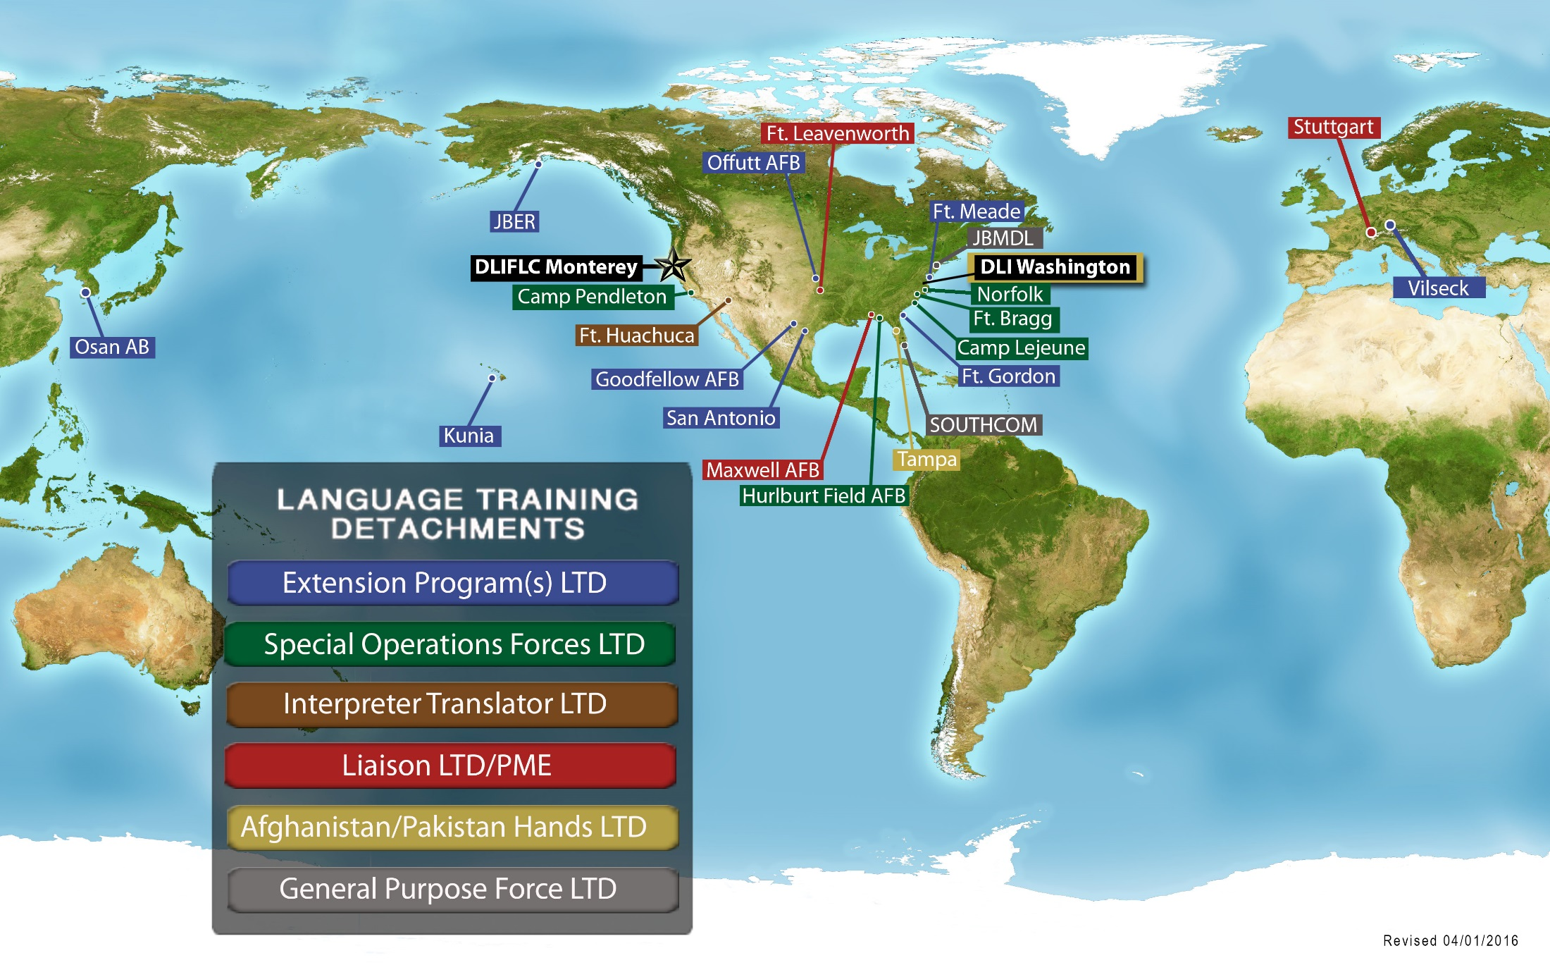
Worldwide Presence
As of April 1, 2016

Slide 14
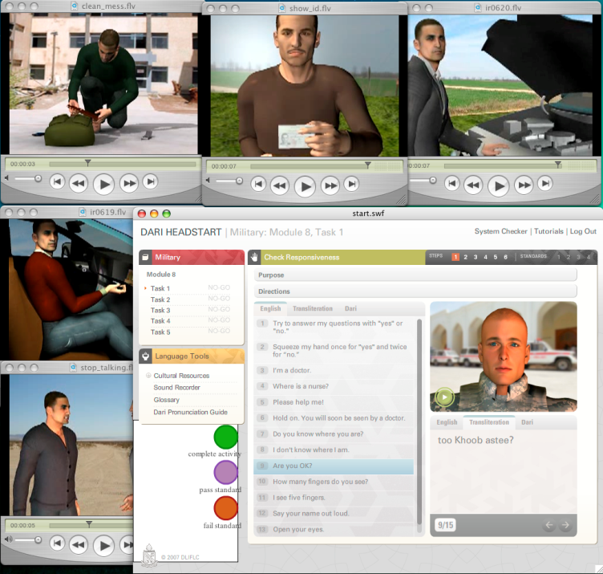
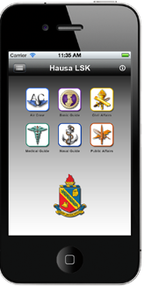
Online Resources (dliflc.edu)
DLIFLC postured to support Nation’s language needs
- Rapport – 6-8 hrs. language & culture trng.
- HeadStart2 - 80-100 hrs. trng. - 32 languages
- Language Survival Kits - 93 languages
Sustainment materials
- Cultural Orientation - 95
- Countries in Perspective - 75
- GLOSS - 40 languages
- ODA - (diagnostic) -18 languages
Mobile Aps
- iTunes
- Google Play
Majority of products are open to the public
Notes:
Online learning: HeadStart2 and Rapport (100hr and 6hr training)
HS2 Languages: Arabic (Modern Standard Arabic) Brazilian, Portuguese, Cebuano, Chavacano, Baluchi,
Chinese (Mandarin), Dari, Egyptian, European Portuguese, French, German, Hausa, Iraqi, Korean, Kurmanji, Levantine,
Moroccan, Pashto, Persian Farsi, Punjabi, Russian, Somali, Spanish, Swahili, Tagalog, Tausug, Turkmen, Urdu, and Uzbek
Provides 3-10-week courses supporting PACOM, CENTCOM, & AFRICOM: Indonesian, Tagalog, Thai, Korean, and Japanese
Provides regional language & culture training:
Ft. Bliss: MSA and French
25th Infantry Division, Hawaii
JBLM: Indonesian, Tagalog, Japanese
Stuttgart and Vicenza
JBLM – Joint Base Lewis-McChord

Slide 15
Linguistic Testing
Notes:
(Video file: 20150623_PPS5_Testing.wmv)

Slide 16
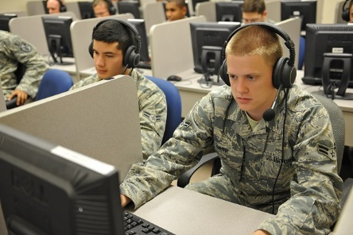
Linguistic Testing
1st DLPT5 deployed: Dec 2005
DLPT examinees per year = ~ 62,000
OPI examinees per year = ~ 15,000
Languages tested = 120 (60 DLPT/ 60 OPI)

Slide 17
Language Proficiency Assessment Division (LPAD)
Develop, validate, administer, sustain, and assess results of standardized language proficiency tests; educate on standards and evaluate student feedback, all in support of the Defense Foreign Language Program.

Slide 18
DLPT5 Overview
Criterion referenced (ILR) 5th generation of the Defense Language Proficiency Tests.
First test deployed in DEC 2005.
2 formats (2 linear forms per skill):
Constructed response (CRT) (examinees < 200/yr).
Multiple choice (MCT) (examinees >= 200/yr)
Scores reported:
Lower range (LR): ILR 0+ to 3
Very low range (VLR): ILR 0+ to 1+
Upper range (UR): ILR 3+ to 4

Slide 19
Test Production
Test platforms:
Multiple Choice (MCT) – high volume (>200/yr).
Constructed Response (CRT) – low volume.
Standard development latency: ~30 months.
Standard development cost (Listening + Reading): ~$1.25M.

Slide 20
OPI Overview
Languages tested = 107 (54 have no DLPT)
Volume delivered in CY15 = 17,226
Volume distribution: 20% DLI; 80% contract
DLI test:
Faculty testers (collateral duty).
Face to face.
Contract:
Telephonic.

Slide 21
Challenges
Students
Motivation of undergraduate students
Intensity / length of program
Faculty
Recruiting & Retention
Teaching to higher levels
Curriculum
Undergraduate curriculum for higher levels
Undergraduate graduation 2+/2+ by 2022

Slide 22
Opportunities
Testing standardization DLPT (ILR) & STANAG 6001
Norming and field testing
Testing seminars
Participants & facilitators
Online tools
dliflc.edu
SharP
Shared curriculum
Teaching to higher levels
Academic Language Academies (ALA)
Bilateral Engagement

Slide 23
Questions?
Colonel Keith Logeman Assistant Commandant, DLIFLC

